Slide 1
Brand Management Process Improvement
A Proposal Document for Clorox
February 4, 2003

Slide 2
Agenda
Our Understanding
Approach
Next Steps
Appendix 1 : Case Studies
Appendix 2 : Illustrative Deliverables
Appendix 3 : Resumes
Appendix 4 : Representative Engagement Experience

Slide 3
You wish to develop and migrate to the next generation brand management model
Clorox has generated impressive marketplace results, in significant part due to the contribution of brand management. That said, a number improvement opportunities remain. You wish to systematically review the current model to develop and migrate to the next generation brand management model
One area of dissatisfaction is the amount of time spent by brand management resources on operational follow-up. These divert talented people’s time to low value tasks, and dilute the focus on high impact tasks like consumer insights identification, and development of brand strategy and equities that comprise brand management’s unique contribution to market results
Another area is the excessively bottom up nature of activity where key recommendations flow from the brand group and senior management is often in the role of refining and counselling. This does not fully leverage their experience. Nor does it fully exploit the potential for category strategies to provide focus and direction to brands
Finally, the weak nature of processes results in a model where strong individuals can cope well, but sustaining institutional capability is not built. As a result people sometimes reinvent the wheel, requiring more work than is necessary

Slide 4
Your situation is not unusual, and exists for historical reasons…..but the environment is evolving
Brand management has been the core skill of consumer product companies, offering prestige and unparalleled opportunities for career advancement
As consumers, customers and competitors have evolved, product development, product supply, and sales have become more vital to success. They have also built stronger capability and skills. This is as true at Clorox as at other companies
These adjacent functions have also developed process strengths that were not always evident before. This offers an opportunity for brand management to shed operational follow up tasks and refocus its time to its own distinctive competencies
Also, the culture of consumer product companies has mythologized the ‘brand manager as hero’. This is increasingly confronting the reality of category management at large customers and the corresponding need for top down category management within the company
Brand management is the highest value activity for consumer product companies…..and possibly the least examined !

Slide 5
We discussed a number of directions to define the next generation brand model
Brand Management Framework
Principles of The Next Generation Brand Management Model
Isolate vital consumer insights to drive downstream initiatives and develop robust category strategies to frame brand roles
Place greater responsibility on senior management to do so, deriving greater leverage from their experience
Strategy
Strengthen processes discipline, including clarifying roles with adjacent organizations and creating service level agreements to define expectations for deliverables, services, timing and issue escalation
Strengthen adjacent functions to enable them to fulfil process roles
Lay out clear role definition between category and brand managers. This is as vital as process clarity
Process and Roles
Performance
Measures
Align metrics and incentives to the refined focus of brand and related organizations
Staffing and Skills
Use clarified role definitions to establish brand management career paths
Legitimise culture by encouraging senior management to model new behaviours
Culture

Slide 6
The intent is to shift the focus of brand management activity towards its unique competence, increasing brand value and growth potential
Before
After
Plan and Manage the Business
Plan and Manage the Business
Create annual plan
Set budget
Measure performance
Create annual plan
Set budget
Measure performance
▪
▪
▪
▪
▪
▪
Build Brands
Build Brands
Build Brands
Build Brands
Drive Insight
Innovate
Build Brand
Market
Equity
Build Brand
Drive Insight
Innovate
Equity
Market
Build Business with Customers
•
Order to Cash
•
–
Customer Planning and Management - Sales and channel, promotions, account planning
Manage top line sales and profitability
Build Business with Customers
•
Order to Cash
•
Customer Planning and Management
Supply Products
–
•
Plan
•
Source
•
Manufacture
•
Deliver
Supply Products
•
Plan
•
Source
•
Manufacture
•
Deliver
Support Functions (Legal, HR, Information Technology)
Support Functions (Legal, HR, Information Technology)
Making this happen needs not only process discipline, but also a redefinition of roles and robust change management to shift long established practices and mindsets
Scope of Redesign Project

Slide 7
A brand process framework
Backup
Build Brands
Gain Insight
Innovate
Build Brand Equity
Market
Objectives
Analyze and integrate consumer and market insight into business decisions
Develop and share relevant hypothesis and recommendations
Maintain robust product pipeline
Establish and maintain product quality and superiority
Establish strategic agenda for brand within category
Ensure preservation and enhancement of brand equity throughout lifecycle
Influence customer behavior
Ensure maximum impact and leverage all synergies across all brands and products
Reduce risk of overloading internal or external resources
Key Activities
Research consumer and market trends
Conduct focus groups and other primary research
Develop and share key learnings
Generate ideas
Research science
Develop products
Prepare product for commercialization and launch
Set brand strategy
Determine opportunities for brand positioning and extension (e.g., pricing, packaging, targeting, etc)
Create communication plan
Develop integrated marketing plan
Execute marketing plan
Monitor marketing plan
effectiveness
Organizational Requirements
Data collection and analysis capabilities
Cross-functional collaboration between customer-facing and marketing functions
Ability to collaborate with third party research firms
Top product researchers and developers
Strong cross-functional collaboration between research, development, marketing and manufacturing
Project management
Ability to identify and react quickly and successfully to market shifts and trends
Strong communication/ collaboration between customer facing and marketing functions
Agency management
Strong collaboration with Supply Chain and Sales functions
Communications with legal function
Enabling Tools
Accessible data collection and reporting
Common standards for product quality and efficacy
Approval protocols and processes
Approval protocols and processes
Marketing results reports

Slide 8
Based on our experience with other CPG companies, we believe five elements are key to the success of this redesign:
Process skills and discipline. This is a basic building block
Real world CPG experience. Process clarity matters, but at the end of the day, brand management is not an ‘industrial strength’ process. Crafting the right roles and skills is as important and benefits greatly from the nuances that only come with real world experience of brand management
Collaborative approach. This is a shared task with plenty of back and forth. Not one where the consultants interact lightly and come back with the ‘right’ answer at the end
Ability to execute and manage change. These are key to moving from reports to realized value. All the more so in an arena with strong mythology some of whose elements run counter to the direction of change. For example, we design our ‘discovery’ phase to yield not only a current process but also a compelling case for change
Understanding of Clorox, and how to work effectively
NOTE: See Appendix for Case Studies
Our approach is based on these elements

Slide 9
Agenda
Our Understanding
Approach
Next Steps
Appendix 1 : Case Studies
Appendix 2 : Illustrative Deliverables
Appendix 3 : Resumes
Appendix 4 : Representative Engagement Experience

Slide 10
Scope and Objectives
Scope
Assess major opportunity areas and redesign brand management to reduce churn and achieve executional excellence in support of growth strategies
We are planning on the assumption that the different brand groups and categories have similar models and that we are designing towards one model. If there are significant variations expected or different models are intended, we will need more detailed discussion to adapt this proposal
Objectives
Define as-is environment, examining the root cause of process and structure inefficiencies
Re-engineer process; and
Create an actionable plan for change

Slide 11
Approach overview
Phase I – Discovery
1 week
Stage I
Define Program
Define the appropriate “playing field” and conduct Rapid Process Change training
6 weeks
Stage II
Assess As-Is State and Opportunities
Conduct interviews and workshops to identify a list of key issues
Prepare high-level “as is” process maps
Phase II – Design
6 weeks
Stage III
Design
Categorize key issues into four groups: process inputs, process steps, structure and performance measures
2 weeks
Voice of the Customer
Best Practices
Guiding Principles
Process Redesign
Principles
Phase IV
Plan for Implementation
Identify and prioritize key opportunities.
Refine opportunities, assess alternatives and develop benefits case
Total project duration 15 weeks
Not Proposed Here
Phase III
Implement Improvements

Slide 12
Approach details
1. Define Program
2. Assess As-Is State and Opportunities
3. Design
4. Plan for Implementation
Key Activities
Refine scope, issues and deliverables
Develop detailed project plan
Schedule executive interviews
Establish working groups based on major process areas and principles for participation
Schedule steering committee reviews
Understand brand management vision/strategy
Develop as-is process maps and organizational charts
Understand key activities & touch points
Hold workshops to understand impacts of as-is environment and discuss opportunities for improvement (e.g., process hand offs w/other groups)
Inject best practice examples via subject matter expert interviews and secondary research
Understand impacts and need to reflect existing redesign work (e.g., CPM, and Project Delta)
Ratify priorities via steering team review
Develop high level requirements for redesign (design principles)
Create design workshop agendas
Assess impact of new requirements and required changes
Define touch points with other functions
Define new roles and responsibilities based on amended scope
Requirements to increase efficiency and effectiveness for example access to data (e.g., CPM and Project Delta)
Define performance metrics
Define impacts to enterprise tools and linkages to existing process initiatives
Analyze gap between as-is and to-be
Define initiatives and implementation priorities
Develop phasing timeline and milestones
Understand resource requirements
Assess business impacts and risks and develop mitigating strategies
Understand business case (e.g., high level investment parameters, resourcing, etc.)
Develop transition plan
Deliverables
Mobilized team
Project plan
As Is environment
Prioritized opportunities
Design principles and vision for brand management operations
Brand Management operational model including processes, roles and responsibilities, metrics and enabling tool requirements
Gap analysis
Initiatives and priorities
Implementation plan
Transition management and communications plan
NOTE: See Appendix for Sample Deliverables

Slide 13
Project team structure
Marketing Advisory Team
IBM BCS
Subject Matter
Experts
John Bess
Frank Pringle
John Breuer
Strategic Team
Nick Feimer, VP Worldwide Consumer Insights
Tarang Amin, VP Laundry, Homecare
Derek Gordon, VP Food
Doug Milliken
Clorox: SO, S&OP Tim Bailey; R&D - Francine ; Marty Thompson - Director of Sales; Lyne Brown - Director of Sales, responsibility for BBC; HR – Marilyn Leahy; Finance – Nina Chow, Controller
IBM BCS: Vivek Kapur, Joe Marino
Project Management
Clorox: TBD
IBM BCS: TBD
Project Execution
Clorox: Part Time - TBD
IBM BCS: 3 Full Time
NOTE: Number of working groups will depend on opportunities identified in Discovery Phase. Actual staffing will depend on timing of project

Slide 14
Project team roles and responsibilities
Steering Teams | Set the directives and vision for the project Identify the major issues and milestones Define the scope and agreements between BCS and Clorox Monitor progress and resolve issues
Marketing Advisors | Provides business context for brand management requirements Works with Steering Committee to ensure relevance across Clorox SBUs (Auto Care, Brita, Cat Litter, Charcoal, Food Products, Glad, Home Care, Insecticides, Laundry care, Professional Products) Helps communicate project change agenda and ensure buy in across brands
Project Management | Manage day to day execution of plan Monitor the budget and deadlines Report regularly to the Steering Committee and Marketing Advisors
Project Execution | Develops as is picture Defines processes and roles and responsibilities Responsible for analysis and creation of deliverables
Subject Matter Experts/ Project Advisors | Provide subject matter expertise and guidance

Slide 15
Agenda
Our Understanding
Approach
Next Steps
Appendix 1 : Case Studies
Appendix 2 : Illustrative Deliverables
Appendix 3 : Resumes
Appendix 4 : Representative Engagement Experience

Slide 16
Next Steps
Confirm feedback and input
  Steering Team and Marketing Advisory Committee membership
  Organizational scope
Adapt proposal and finalize Statement of Work
Target start date

Slide 17
Agenda
Our Understanding
Approach
Next Steps
Appendix 1 : Case Studies
Appendix 2 : Illustrative Deliverables
Appendix 3 : Resumes
Appendix 4 : Representative Engagement Experience

Slide 18
IBM BCS applied this framework to assist a leading apparel company to improve its go-to-market processes
Situation
Our client, a leading apparel brand and marketing company, holds some of the most highly recognized brands in the market. However, senior executives were troubled by the lack of effectiveness in the company’s go-to-market processes. They observed ongoing territorial issues and were concerned that unclear processes were hampering their ability to collaborate across functional and geographic units
Actions and Findings
We focused on three key processes: consumer marketing, channel marketing and in-store presentation
We identified and gained active support of key executives, process participants and corporate stakeholders
Conducted workshops to clarify and document process steps through detailed maps
Clarified and documented process roles and responsibilities
Identified and prioritized areas for further improvement, sized benefits and resource needs, and developed an implementation plan
Contrary to what the organization believed, we found that the process itself was clear. However the roles were not. Consequently, people had overlapping definitions of their roles resulting in conflict, second guessing, frustration, delays and weak market impact
Results
:
Sharper role definitions
Reduced cycle times
Improved collaboration across functional and geographic units, increased market impact, higher morale
Reduction in headcount due to efficiency gains

Slide 19
Project approach
~2 weeks
Stage I
Mobilize Team
Define the appropriate “playing field” and conduct Rapid Process Change training
~3 weeks
Stage II
Assess Processes
Conduct interviews and workshops to identify a list of key issues
Prepare high-level “as is” process maps
~4 weeks
Stage III
Evaluate Opportunities
Categorize key issues into four groups: process inputs, process steps, structure and performance measures
~5 weeks
Phase IV
Prioritize Improvements
Identify and prioritize key opportunities.
Refine opportunities, assess alternatives and develop benefits case
Voice of the Customer
Best Practices
Guiding Principles
Process Redesign
Principles
Approximate project duration 14 weeks
Timing TBD
Phase V
Implement Improvements

Slide 20
We mapped the “as is” processes….
Sample deliverable
Brand
Brand Team
Consumer
Ad Agency
Consumer
Yes
Ad Agency
Consumer
Team
allocates
Marketing
generates
Marketing
Approved?
develops,
Marketing
develops
A&P Budget
develops
creative
reviews creative
coordinates
approves
Strategy
Creative Brief
Alternatives
options
and executes
Advertising Media
Brand
No
Advertising
Plan
Brand
Consumer
Consumer
Ad Agency
Consumer
Marketing
Ad Agency
Marketing
Yes
Media Dept.
Marketing
Approved?
Yes
develops
develops
reviews
Approved?
purchases
reviews
Media Briefs
Media Plan
Media Plan
Media
Execution
No
options
No
Consumer
Marketing
Consumer
Consumer
Consumer
oversees all
Marketing
Yes
Marketing
Yes
Marketing
stages of
reviews
Approved?
reviews
Approved?
provides
execution
plan
options
Program
No
briefs
No
Depending
Marketing
on Scope
P&P
Marketing
investigates
Services
Services
Market
P&P reviews
and develops
Research
Briefs and
program
performs
assesses
copy test
execution
P&P
alternatives
P&P briefs
Execution
presents
P&P
External
options
execution
executes
publicity
presented
options to
and/or
agency
to P&P
Consumer
oversees
Market
Marketing
execution
Market
Media
P&P
Research tests
Research
P&P develops
Department
develops
program
provides target
promotion and
provides
program
options
information to
publicity plan
POV
options
Internet
Brands
Depending
on Scope
develops
Internet
program
Internet
reviews
Internet
Program brief
Internet
creates
develops
and assesses
Internet briefs
Options
presents
and/or
Internet
online options
execution
External Web
presented
options to
oversees
develops
alternatives
Agency
to Internet
Consumer
execution
online plan
Market
CBD
CBD
RMMS present
Advertising and
Media Plan to
Accounts to
Provide Strategy,
Direction and Budget
Develop
Tactical Plans
drive sales
Review and Approve
Program Alternatives
Execute Programs
1. Refine brand-led strategic inputs
2. Modify brand strategy communication process
6. Standardize brief templates
9. Develop and execute brief writing and content development training
3. Create annual marketing calendar
4. Develop Brand Marketing and Marketing Services role matrix
5. Develop service level agreements between Brand Marketing and Marketing Services
7. Create brand team manager role

Slide 21
….and identified improvement opportunities using a structured framework
Sample deliverable
Consumer Marketing
Issues
Opportunities
Business Impact
Process inputs unstable or too high-level
1. Refine Brand-led strategic inputs
Shared Values
Strategic Elements: Process Inputs
Process and roles ill-defined, causing:
2. Modify brand strategy communication process to tailor messages to selected audiences
3. Create annual marketing calendar aligned with GTM merchandising calendar that incorporates key milestones and key Account milestones
4. Develop Brand Marketing and Marketing Services role matrix to provide consistency and clarity of roles, responsibilities and accountabilities of project team
5. Develop service level agreements between Brand Marketing and each of the Marketing Services’ departments
6. Standardize briefs (media, communications and program)
Strategy
Role confusion
Ineffective hand-offs
Wasted efforts or activity gaps
Process instability
Process and Organizational Elements:
Process
Questions abound regarding optimal reporting relationships
7. Create brand team manager role to manage projects using Marketing Services for execution and brand team for strategy
8. Consider structural alternatives between Brand Teams and Marketing Services that enhance collaboration and that use Marketing Services and Brand Teams skills more effectively
TBD
Structure
Performance measures lacking, inconsistent or used ineffectively
Performance measures to be addressed later in the project
Performance Measures
Staffing
Overstaffing around process redundancies; understaffing around process gaps
To be resolved during implementation
Skills
Skill gaps and under-training are significant issues
9. Develop and execute Brief writing and content development training
High
Low

Slide 22
We assessed these opportunities for their business impact
Sample deliverable
Opportunity
Benefits
Type
Opportunity 4
Develop service level agreements between Brand Marketing and each of the Marketing Services’ departments
Customer Service
Productivity
Revenue
Cost Savings
Clarifies roles and responsibilities
Defines service levels
Opportunity 5
Develop Brand Marketing and Marketing Services role matrix to provide consistency and clarity of roles, responsibilities and accountabilities of project team
Customer Service
Productivity
Revenue
Cost Savings
Eliminates duplicate efforts
Provides clarity among roles and departments
Decreases number of hand-offs
Enhances collaboration
Eliminates confusion of program/event management
Reduces work
Decrease program spend

Slide 23
“To be” process maps developed a common understanding of the process
Sample deliverable
Brand
1.2.2
Develop Marketing Plan
Approve Marketing Plan
A = Accountable
R = Responsible
C = Consult
I = Inform
New/emphasized role within process
New process step
1.2.1
Kick-off Marketing Plan development
1.2.3
1.3.1
Consumer Marketing develops Communication Brief
1.4.1
Consumer Marketing reviews and approves creative options
1.5.1
Steering Committee Change
Brand Team
Approved?
Yes
Ad Agency
allocates
develops,
A&P Budget
coordinates
and executes
3.1.14
Consumer Marketing reviews program’s results
Advertising
3.1.1
Consumer Marketing creates MS Briefs
2.1.1
Consumer Marketing develops Media Brief
2.1.4
Consumer Marketing reviews and approves Media Plan
Yes
Yes
Approved?
Approved?
3.1.3
3.1.5
Consumer Marketing reviews and approves options
No
3.1.6
No
Consumer
Approved?
Yes
Approved?
Yes
Consumer
Marketing
Marketing
reviews
provides
plans
No
Program briefs
Marketing Services
No
3.1.8
P&P investigates and develops program
1.4.2
Market Research Performs
copy test within corporate framework
Depending
3.1.7
on Scope
P&P reviews
Briefs and
2.1.5
Ad Agency Media Dept. Purchases Media
assesses
3.1.11
P&P presents execution plan Consumer Marketing
2.1.2
Media Department provides POV
2.1.3
AD Agency develops Media Plan
execution
3.1.9
3.1.10
Execution options presented to P&P
3.1.12
P&P executes and/or oversees execution
3.1.13
Measure program’s effectiveness
alternatives
P&P hires and
briefs External
3.1.4
P&P Develops Program options
3.1.71
Publicity Agency
1.1.1
3.1.2
Market Research
P&P develops
tests program
Market Research gains complete understanding of relevant market research
promotion and
options
3.2.4
Internet develops program
publicity plan
Depending
3.2.3
on Scope
3.2.8
Internet creates and/or oversees execution
3.2.2
Internet develops online options
Internet reviews
3.2.7
Internet presents options to Consumer Market
3.2.9
Measure program’s effectiveness
Program brief
3.2.6
Options presented to Internet
3.2.1
Internet develops Online plan per the global framework
and assesses
3.2.5
Internet briefs External Web Agency
execution
alternatives
CBD
2.1.6
RMMS present Advertising and Media Plan to Accounts to drive sales
3.1.15
CBD reviews program’s results
Provide Strategy,
Direction and Budget
Develop
Tactical Plans
Review and Approve
Program Alternatives
Execute Programs
1. Refine brand-led strategic inputs
2. Modify brand strategy communication process
6. Standardize brief templates
9. Develop and execute brief writing and content development training
3. Create annual marketing calendar
4. Develop Brand Marketing and Marketing Services role matrix
5. Develop service level agreements between Brand Marketing and Marketing Services’ departments
7. Create brand team manager role

Slide 24
However, the key in this case was the clarification of roles and responsibilities. This was difficult to work through, but dramatically improved the situation
Sample deliverable
A = Accountable
R = Responsible
C = Consult
I = Inform
New/emphasized role within process
New process step
Brand Team
Marketing Services
CBD
Steering Committee Change
RED
Visual
Merchandising
Store Design
SP&D
Consumer Marketing
Market Research
P&P
Media
Internet Marketing
RPMs
RMMs
MCs
Field Sales
Accounts
Process Steps
Retail Communications
External Agency
Activity
3.2.1
Develop Online plan per the global framework
A
R
3.2.2
Develop Internet program options
A
C
C
R
I
I
3.2.3
Review Internet Program brief and assess execution alternatives
A,R
I
C
I
3.2.4
Develop Internet program
A
I
R
I
3.2.5
Brief external Web Agency
A
R
I
Online
3.2.6
Present options to Internet
A
R
C
3.2.7
Present Internet options to Consumer Marketing
A
I
R
C
3.2.8
Create and /or oversee Internet program execution
A
I
R
I
3.2.9
Measure program’s effectiveness
A
I
C
C
R
I
I
I
1.3.1
Develop Communication brief
A,R
I
I
I
I
1.4.1
Review Advertising alternatives
A,R
C
C
C
Advertising
A
R
1.4.2
Perform copy test within corporate framework
I
C
1.5.1
Develop, coordinate and execute advertising
A,R
I
I
I
I
I
C
2.1.1
Develop Media brief
A,R
C
C
2.1.2
Provides Media POV
A
R
C
Media
2.1.3
Develop Media plan
A
R
C
2.1.4
Review and approve Media plan
A,R
C
C
C
2.1.5
Purchase Media
A
R
C
2.1.6
Present Advertising and Media Plan to Accounts to drive sales
A
C
C
C
R
C

Slide 25
It was also essential to set clear expectations for the performance the different groups owed each other. We captured this in service level agreements
  The team drafted Service Level Agreements were drafted between Consumer Marketing and the following departments:
      Presence & Publicity
      Media
      Internet Marketing
      Market Research
The client will use Service Level Agreements to:
  Ensure proactive planning and collaboration between Brand Teams, Worldwide Marketing Services and Sales
  Establish more effective working relationships among the marketing departments responsible for developing and executing the Consumer Marketing process
  Establish common goals and develop clear accountability for their achievement
Notes:
Transition:
Draw a correlation between the exercise which was just completed and these eight factors.
Key Points:
Successful Process Change efforts requires eight key factors. We have talked about executive commitment and a structured approach but other factors are also important.
- Knowing what to do and focusing efforts
- Getting the right resources
- Effectively managing the effort
- Training employees
- Demonstrating early success

Slide 26
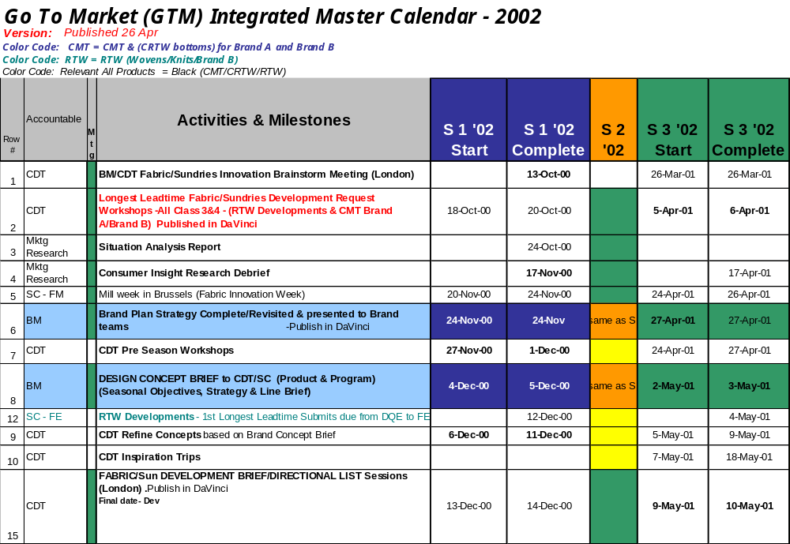
We created a Go-to-Market calendar as a coordinating tool, giving process participants across all functions a clear and common understanding of their deadlines
Sample deliverable

Slide 27
Finally, we developed performance measures to track process performance. These were incorporated into service level agreements and marketing briefs
Sample deliverable
Financial Measures
Customer Measures
Market Share (vs. comp.)
1. Dollar volume
2. Unit volume
Marketing Benchmarking
(Tactical, Coop, Advertising, Promotion and Internet)
7. Spending as a % of sales
8. Spending vs. budget
9. Spending vs. competitive spend
1. Product sell-in rates
Sales
3.Total and per sku dollar & unit sales vs. year ago
4.Total & per sku dollar & unit sales vs. previous period
5. Dollar & unit sales per door
6. Dollar & unit sales per square foot by shop
2. Product sell-through rates
3. Account satisfaction measures
Return on Investment
10. Tactical
11. Shops
Consumer Business Process Measures
People Development Measures
Brand Equity
1. Top of mind brand awareness
2. Advertising awareness
3. Brand imagery
Program Effectiveness
8. On-time delivery
9. Consumer and Account participation levels
10. Purchase intent
1. Employee satisfaction
2. Training Accomplished
3. Internal customer satisfaction survey (two-way)
Media
4. Reach
5. Frequency
6. Advertising Target Rating Points (TRP)
7. Share of Voice (SOV)
4. Performance by level
Red highlight - Key measures for Marketing Briefs and Service Level Agreements
Notes:
Transition:
Draw a correlation between the exercise which was just completed and these eight factors.
Key Points:
Successful Process Change efforts requires eight key factors. We have talked about executive commitment and a structured approach but other factors are also important.
- Knowing what to do and focusing efforts
- Getting the right resources
- Effectively managing the effort
- Training employees
- Demonstrating early success

Slide 28
Agenda
Our Understanding
Approach
Next Steps
Appendix 1 : Case Studies
Appendix 2 : Illustrative Deliverables
Appendix 3 : Resumes
Appendix 4 : Representative Engagement Experience

Slide 29
In a second case, we assisted a large food client in becoming more customer focused, dramatically improving market results
Situation
The client’s brands were widely recognized and profitable, but stagnating. It faced weakening economics due to rising inventory and trade spending. The resolution of these issues lay with retail customers but the company was hampered by a legacy view of customers as a “necessary evil” in reaching consumers
Action
We helped the company reconfigure its innovation processes and skills to drive sharper consumer insights and increase the pace of innovation
The client adopted an objective of becoming a leader in customer partnerships and developed stronger customer processes, supported by actions to develop a synchronized, demand-driven Supply Chain
Improving organizational effectiveness to link functional areas
Developed and implemented performance metrics to support the new business model
Results
Revenue: +9% CAGR
Market Share +7% CAGR
Order Fill Rate +22pp
Cost Reduction: -22%
Inventory turns: 6x improvement
Operating Income: +13% CAGR
Economic Value Added: +23% CAGR
* Impact after two years

Slide 30
The project was comprehensive, tackling improvement programs for key customer and consumer processes
Collaborative Annual Planning
Value-Added Service Development
Key Customer Processes
Category Management
Demand Planning and Communication
Generate Consumer Insight
Innovate : New Product Pipeline
The following slides cover these processes in further detail
Key Consumer Processes
Innovate : New Product Development and Execution
Market : Promotion Development & Execution

Slide 31
As a result of the project, the Consumer Insight process was improved with more focused and rigorous analytics
Consumer Insight Process
Beginning State
Didn’t distinguish between information, understanding, and insight
Unmanaged consumer learning
Bias towards analysis
Absence of cumulative learning
Imbalance between analytical and intuitive/creative skills
Blurred accountability for insights
End State
Separate the information/ understanding and insight parts of the process
Hold senior marketing personnel accountable for insight identification
Focus research spending on more strategic issues
Implement better decision support systems
Incent continuity, skill development, and contributions to insights

Slide 32
The improved New Product Pipeline process was tied more directly to corporate goals and executed with cross-functional expertise
New Product Pipeline Process
Beginning State
No formal process in place: episodic “projects” vs. process
Role of new products unclear
Market research drove the process
Operating in functional silos
No metrics
End State
Continuous sourcing of ideas
Dedicated multi-functional team
Better definition of the strategic role of new products
Clear stages and hurdles between stages

Slide 33
The focus of the New Product Development and Execution Process was to drive gains in efficiency via stronger project management
New Product Development and Execution Process
Beginning State
Activity driven, defined by the research steps
Focused on product attributes versus benefits
Research dominated focused on risk elimination versus risk management
Sequential process steps
End State
Streamlined, objective driven process
Dedicated, multi-discipline team
All work driven from the consumer positioning
A formal Business Proposal as a project management tool

Slide 34
Improved cross-functional collaboration and project management also helped the Promotion Development and Execution Process
Promotion Development and Execution Process
Beginning State
Idea generation to shelf took 18 months
Consumer and customer input not used effectively
Poor understanding of real value of promotions
Unclear roles & responsibilities
Low involvement and high control from Management
End State
Consumer insight driven process
Separate creative from execution activities
One integrated process with an overall project manager
Continuous idea sourcing
Sales and Supply Chain involvement throughout the process
Involve Management upfront

Slide 35
Agenda
Our Understanding
Approach
Next Steps
Appendix 1 : Case Studies
Appendix 2 : Illustrative Deliverables
Appendix 3 : Resumes
Appendix 4 : Representative Engagement Experience

Slide 36
Approach details
1. Define Program
2. Assess As-Is State and Opportunities
3. Design
4. Plan for Implementation
Key Activities
Refine scope, issues and deliverables
Develop detailed project plan
Schedule executive interviews
Establish working groups based on major process areas and principles for participation
Schedule steering committee reviews
Understand brand management vision/strategy
Develop as-is process maps and organizational charts
Understand key activities & touch points
Hold workshops to understand impacts of as-is environment and discuss opportunities for improvement (e.g., process hand offs w/other groups)
Inject best practice examples via subject matter expert interviews and secondary research
Understand impacts and need to reflect existing redesign work (e.g., CPM, and Project Delta)
Ratify priorities via steering team review
Develop high level requirements for redesign (design principles)
Create design workshop agendas
Assess impact of new requirements and required changes
Define touch points with other functions
Define new roles and responsibilities based on amended scope
Requirements to increase efficiency and effectiveness for example access to data (e.g., CPM and Project Delta)
Define performance metrics
Define impacts to enterprise tools and linkages to existing process initiatives
Analyze gap between as-is and to-be
Define initiatives and implementation priorities
Develop phasing timeline and milestones
Understand resource requirements
Assess business impacts and risks and develop mitigating strategies
Understand business case (e.g., high level investment parameters, resourcing, etc.)
Develop transition plan
Deliverables
Mobilized team
Project plan
As Is environment
Prioritized opportunities
Design principles and vision for brand management operations
Brand Management operational model including processes, roles and responsibilities, metrics and enabling tool requirements
Gap analysis
Initiatives and priorities
Implementation plan
Transition management and communications plan
NOTE: See Appendix for Sample Deliverables

Slide 37
As Is Environment
ILLUSTRATIVE
Process Name:
Consumer Marketing Process
Purpose:
Effectively develop advertising and promotional programs that drive increases in sales and market share
Major “As-Is” Process Steps:
Brand Team develops strategy/budget
Market Research provides input on target market
Brand Marketing develops Creative Briefs and Media Objectives and Strategies (Obs. and Strats.)
Media provides input/feedback on media plan (to Brand Marketing and Ad Agency)
Ad Agency executes advertising and media buy
Brand Team develops strategy/budget
P&P develops presence and publicity program options
Brand Marketing reviews/selects program options
P&P executes and/or oversees execution
Brand Team develops strategy/budget
Internet Team develops on-line strategy
Brand Marketing reviews and approves Internet strategy
Internet Team executes on-line efforts internally or manages external execution
FYI-Brand Team remains involved throughout processes
Suppliers
Inputs
Customers
Outputs
Brand Team
ALT
ALT
Market Research
Brand Team
CBD
P&P
OLS
Ad Agencies Business Research
GTM Calendar
SBP and ABP
Annual Vision
Budgetary Direction
Consumer Understanding
Budgetary Constraints
Retailer Feedback
LT Promotional Opportunities
Marketplace Intelligence
Positioning Direction
Competitive Intelligence
Ad Agencies
Marketing Services
Media Plans and Ads
Promotion, Publicity and Internet Programs and Events
Brand Resources
MS Resources
~ 12 Brand 1 Marketing FTEs
~ 12 Brand 2 and Brand 3 Marketing FTEs
~ 35 P&P FTEs
~ 10 Market Research FTEs
~ 10 Internet FTEs
Brand 1
Brand 2
Brand 3
Sales ($M)
A&P $M)
P&P ($M)
Projects Executed
1,824
128
10.0
10
911
70
3.0
8
85
10
.9
5
Notes:
Transition:
After completing the process overview, document the information in the Process Template.
Key Points:
Complete this template with information that you gathered in performing the process overview.

Slide 38
Defined Opportunities
ILLUSTRATIVE
Issue #1: Process inputs are sometimes unstable or are too high-level
Opportunity
Benefits
Type
Opportunity #1
Refine Brand-led strategic inputs to:
Develop detailed strategy and vision
Incorporate rolling 3 year SBP (versus starting from scratch)
Develop annual long-term Marketing Plan (2-3 pages developed by Brand Marketing)
Incorporate Account specific strategies, objectives and allocations
Improves effectiveness
Reduces work
Improves communication and focus on key business drivers
Enhances collaboration
Better aligns LS&Co’s funding cycles with Accounts capital allocation calendars
Customer Service
Productivity
Revenue
Cost Savings

Slide 39
Design Principles
ILLUSTRATIVE
Business Strategies and Operating Principles are the foundation for all recommendations
Business units should be defined by relevant, externally-driven category definitions
Build a total business perspective at critical decision points to get the highest quality decisions as quickly as possible
Build speed and efficiency by getting the work done right the first time
Design quality into work processes; prevention and control activities should occur where the work is done
Business unit managers are accountable for all operational decision making and policy
Discipline councils are responsible for recommending policy and maintaining/ developing their discipline capabilities and skills
Critical skills and the people who have those skills must be located as close to the consumers and customers as possible
Eliminate costs that do not add value to the consumer or customer
Outsource activities that do not drive competitive advantage or where superior advantage can be gained by doing so

Slide 40
Improved Process Map
ILLUSTRATIVE
Brand
4.1.5
Brand Team briefs internal and/or external agency
4.1.8
Consumer Marketing (Levi’s) or RED (D&S) provides visuals
4.1.9 Consumer Marketing presents to RMMs
Met
Yes
Yes
4.1.2
Consumer Marketing provides direction to RMMs
Brand
Approved?
threshold?
No
No
Marketing Services
4.1.6
Develop P&P and/or Internet program options
4.1.7
Present options to Consumer Marketing
1.1.1
Market Research provides target information to Brand Team
CBD
4.1.1
RMMs provide input on Account needs and past successes
4.1.3
RMMs present program options to Accounts
4.1.4
RMMs generate Account specific Program briefs
4.1.10
RMMs develop programs with Accounts
4.1.11
Program executed
4.1.12
RMMs assess program’s effectiveness
Provide Direction and Budget
Create Program Briefs
Assess and Execute Programs
Refine brand-led strategic inputs
Modify brand strategy comm. process
Standardize retail funding brief
Develop and execute brief writing and content development training
New/emphasized role within process
New process step
Develop Brand Marketing, Marketing Services and CBD role matrix
Develop service level agreements between Brand Teams, Marketing Services and CBD depts.
Create annual marketing calendar

Slide 41
Activity Detail
ILLUSTRATIVE
What it is
The Activity Detail Matrix is constructed to ensure clear understanding of each activity performed during execution of the process. Each activity is assigned a unique identifier linking it to the end to end process map, It also includes an activity description, the input that triggers the activity, the product of the activity, applications or data sources used, and relevant additional comments regarding the activity.
Activity ID
Activity Description
Input Condition
Exit Conditions
Applications
Comment
How it looks
DMGR-0110
Develop SOP Forecast
Past Sales history, Sales budget for current year and field contacts, large projects.
12 month bookings plan, 4 quarters booking plan performance by product family, sold/non-sold inventory plan performance for contract sales, Sales planned performance, booking s plan by units, summary forecast by family.
Demand Solutions, Excel
Forecast is in 50/10 dollars. Shows sums and dollars with a 1-month offset.
DMGR-0120
Attend SOP meeting
Bring Sales issues related to operations performance to the meeting.
Explains Sales strategy. Raise issue with Operations short falls on performance.
None reported
Issues not very specifically framed – “they always/never…” data difficult to obtain

Slide 42
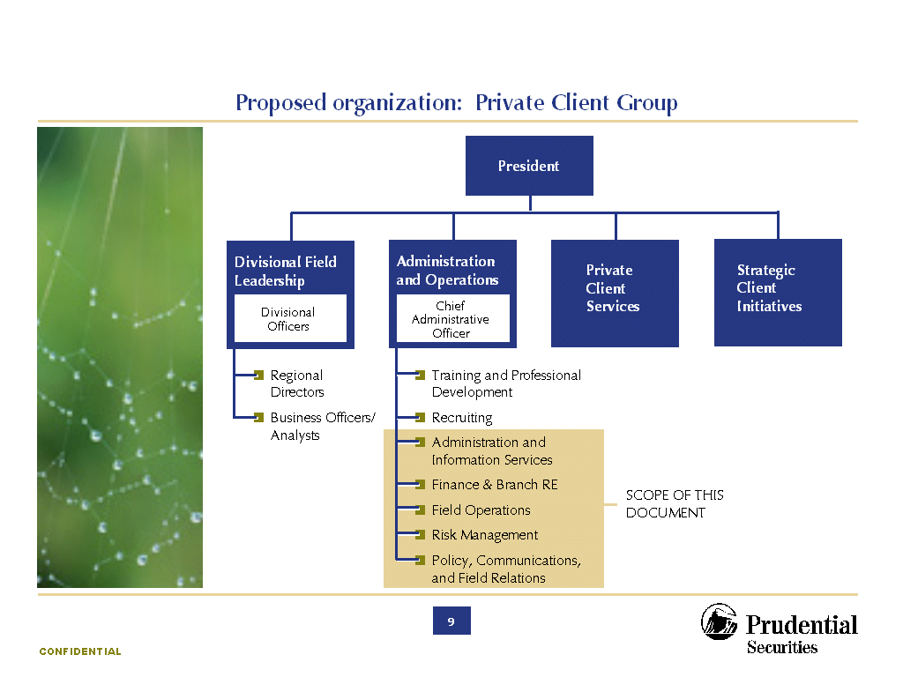
Organization Design Report
ILLUSTRATIVE
What it is
The comprehensive document listing:
  Organization structure (org chart, spans of control, operating model)
  Departmental accountabilities
  Roles
  Responsibilities
  Integrating mechanisms
  Linkages to performance management
Proposed Organization: Design Principles
We developed the new organization structure, roles and behaviors by basing them on a handful of guiding design fundamentals
How it looks
Integration: | Consolidating and centralizing admin and ops functions in a manner to eliminate silos – across divisions and between home office and field
Proactivity | Setting job expectations and performance measures to emphasize activities that anticipate and facilitate opportunities to meet the six drivers
Service: | Instilling a culture of responsiveness, accessibility and solution orientation – to field “customers” and external clients – that is measured by service contracts
Consistency: | Clearly defining, quantifying and enforcing policies and procedures
Information: | Easy and direct access to management information to make decisions; and prompt and clear communication of management and leadership information to the field
Flexibility | Agility of the policies and structure to be responsive to changing marketplace demands and firm wide growth

Slide 43
RACI Chart
ILLUSTRATIVE
What it is
A “cross check” document to ensure nothing “falls between the cracks” in implementing the designed solution. The team considers workflow and determines how each step will be completed. The RACI Chart calls out the responsibilities various roles may have in carrying out each step:
  Responsibility (the people responsible for making a work-flow step happen)
  Accountability (the person or department that will take the heat if work isn’t completed appropriately)
  Consulted (when a party will be asked to weigh in on making a decision or in validating a choice)
  Informed (when a party knows of the occurrence but is not being asked to participate.
How it looks
Promotion Process/Role | Finance | Marketing | Promotion Manager Group | Project Leadership
Activity A | I | C | R, A | C
Activity B | I | C | R | A
Activity C | I | C | R | A
Activity D | I | I | R, A | C
Activity E | I | C, I | R | A
Activity F | C, I | R, A | R, A | C, I, R
Activity G | I | I | C | R, A
Activity H | C | I | C | R, A
Activity I | C, I | C, I | R, C | A

Slide 44
Implementation Plan
ILLUSTRATIVE
Phase 1
Phase 2
Critical Success Factors
Develop Partnership Strategy
Define roles & responsibilities
Schedule Steering Committee strategy sessions
Communicate strategy
Develop stakeholder management plan
Facilitate negotiations with external customers
Communicate changes, transition plans to stakeholders
Document external customers expectations and needs
Define/Implement Near-Term Structure
Design Near-Term structure
Communicate N-T structure - establish reporting relationships
Communicate Future State structure
Implement N-T structure
Identify units most impacted by changes; prioritize for unit-level design work
Articulate staff-level org structures
Conduct unit-level analysis and design
Decide on transition timing
Create and staff new functions (Decision Support, etc.)
Begin migration of departments under new functional groupings
Business Process Analysis
Identify critical business processes
Build process review and improvement teams
Develop a prioritized list of processes to be reviewed
Conduct pilot end-to-end process assessment for processes with immediate need (e.g., closing process)
Implement initial process changes
Skill and Competency Assessment
Define skills and competencies required to support future organization
Begin assessment of current staff
Complete assessment of staff
Conduct gap analysis between current and required skills
Define selection process and cross-over into new roles where applicable
Begin to develop of recruiting and training strategies
Transition Project Office
Create and staff transition office
Identify near-term transition leader
Develop a prioritized project portfolio
Develop/obtain tools and methodologies to support transition function
Formulate change management plan based on transition plan
Communicate changes to entire organization - strategy, transition, structure, impact on roles, etc.

Slide 45
Performance Metrics Table
ILLUSTRATIVE
What it is
Determining an organization’s change readiness will tell us which organizational elements will enhance or pose a barrier to a smooth transition. Thus, we evaluate change readiness to minimize risk around implementing any change. The graph below demonstrates, for one company, which areas needed the most focus from a risk perspective. Change management activities for this project largely reflected the outcomes of the survey.
How it looks
Metric Name
Description
Unit of Measure
Target
Ave-rage
High-est
Low-est
Order allocation to marketed lead-time
Number of total orders allocated vs. those allocated within lead-time.
Orders
N/A
490
490
460
% of orders allocated to mktd lead-time
Percent of orders allocated outside of Mfg. Marketed lead-time vs. percentage of orders within marketed lead-time.
Orders
N/A
98%
98%
95%
On time MAD performance
Percent of orders which pack on or before the MAD date.
Orders
98%
75%
99%
40%
On time ship performance
Percent of orders which ship on or before the ship date.
Orders
99%
87%
100%
79%
Change & cancellations to orders received
Number of C&Cs received compared to number or orders received.
Orders
N/A
17%
14%
22%
Dollars booked to plan
Actual dollars booked to the planned (forecast) sales.
Orders
Forecast
8.5%
+15%
-7.4%
Past due
Number of days late to ship past due orders
Days & Orders
N/A
1 day 100
1 day 500
1 day 1

Slide 46
Stakeholder Segmentation Map
ILLUSTRATIVE
What it is
With a limited number of resources and time, the project team must deliberately choose which key influencers need more or less attention in order to assert the benefits and other details of the project. Managing stakeholders allows the project team to get the biggest bang for the buck in where it spends its time communicating. One of the main tools of analysis of stakeholders is the stakeholder segmentation map.
+
Project Sponsors
Project Sponsors
Key Group
Potential Impact on Change
Key Group
How it looks
Armed with the understanding of just how influential various stakeholders are (y axis) and what is motivating their support or opposition (plotted along the x axis) the project team can begin to understand the level of effort (and type of communication) to be associated with communication planning and political influencing. The team will plan more time communicating to key rather than non-influencers. Similarly, a team might try to leverage a stakeholder’s support in communicating to a group that reports to the stakeholder.
All Employees
-
All Employees
-
Support for Change
+
Influence

Slide 47
Communications Plan
ILLUSTRATIVE
What it is
The tool kit is simply a “how-to” guide in constructing a communications plan. It helps the team understand what vehicles are available to serve as a forum for communications. It highlights the order in which activities should be prioritized and helps the team phase communications to the right audiences with the right messages in time for them to effectively perform responsibilities. Communication pieces simply refer to the text, web content, talking points, outline, speeches etc. prepared on behalf of the project per audience.
TARGETED MESSAGES
Design Phase
Stakeholder
Message
Owner
Profile #
Oct
Nov
Dec
Jan
Feb
Mar
How it looks
Cross-Team
Data and Policy Rationalization Process
Red Team
11
12/15
Overview of Implementation and Training Strategy*
Tabs
12
3/13-14
Overview of Target Organization Design*
Tibbs
13
3/13-14
Data and Policy Rationalization Results*
Red Team
14
3/13-14
Supply
Detailed Project Progress Updates
Pawlowicz, Pistner, Sullivan
15
11/22
12/20
1/24
2/21
Data and Policy Rationalization Process
Pawlowicz, Pistner, Sullivan
16
11/15
Demand
Data and Policy Rationalization Process
Desjardins
17
11/15
Customer Differentiation Validation
Desjardins
18
1/13
Customer Service Involvement
Bennett
19
2/3
3/14
Detailed CLM Business Redesign
Bennett
20
3/14
Finance
Corporate Finance Overview
Gleason
21
11/22
Plant Finance Overview - 1
Gleason
22
12/9
Plant Finance Overview - 2
Gleason
23
3/10
Data and Policy Rationalization Process
Gleason
24
11/15
ITS
ITS Updates
Simmons-Lundeen
25
12/13
2/14
HR
HR Updates**
Tibbs
26
11/x
12/x
1/x
2/x
3/x
TOTAL NEW MESSAGES CREATED
0
12
6
5
4
11

Slide 48
Communications Feedback Mechanism
ILLUSTRATIVE
What it is
Communication is only as effective when the audience comprehends the project messages. While on a project team, it is easy to take for granted knowledge gained on the project, but the project team often loses perspective. We set up feedback mechanisms to provide 2-way communications. While the team will generally communicate in mass communications, more targeted one-on-one stakeholder communications may be required. It may also be appropriate for the team to hear and incorporate input from the field.
How it looks
Various communication feedback mechanisms are possible. Some include:
Q/A database or interactive web-site
Hotline
Communications effectiveness surveys
Random sampling of people in the field
Periodic change agent feedback

Slide 49
Change Leadership Training Session
ILLUSTRATIVE
What it is
For people to adhere to the new processes being designed, the project team needs to work together to act as ambassadors of the project to the people over whom they have influence. The project team and sponsors must act as true change agents to inspire others to make the necessary changes. However, managing change is not intuitive to most people. Furthermore, as individuals get entrenched in the design of a new solution, they tend to distance themselves from the way others still think.
How it looks
Change Leadership skills training can cover the following objectives:
Identifying, segmenting and managing stakeholders in order to decrease resistance
Effectively managing meetings
Building commitment through communications planning and training
Engaging team members through learning how to accept feedback

Slide 50
Agenda
Our Understanding
Approach
Next Steps
Appendix 1 : Case Studies
Appendix 2 : Illustrative Deliverables
Appendix 3 : Resumes
Appendix 4 : Representative Engagement Experience

Slide 51
Vivek Kapur
Vivek Kapur is a San Francisco based partner in the Strategic Change Practice of IBM Business Consulting Services. He leads the firm’s Growth Strategy initiative globally, as well as the CRM Vision solution area. He works with executive teams on business transformation strategies, and on issues relating to customers, channels, brands, and value propositions. He has published thought leadership on growth and ebusiness.
Vivek also has extensive international experience and in an earlier role, led the Firm’s consulting practice in China, and strategy engagements in Asia. His clients include leaders in Hitech, and Consumer products: Unilever, Pillsbury, Levis, Calvin Klein, Bacardi, Wella, Heinz, Bristol Myers Squibb, Ford, Caterpillar, Intel, TI, Sun, Micron, etc. Prior to his consulting roles he worked with Procter & Gamble and H.J. Heinz for eight years. Vivek trained as an engineer and received his MBA.
Representative Experience
  Brand Management, sales, and merchandising process alignment for a leading apparel company – This leading marketer of apparel believed its market share was constrained by the effectiveness of its brand management model and go to market processes. We worked with the CEO, Brand Presidents, and the VPs of merchandising and sales to identify pain points and opportunities. We redesigned the model and key processes. We also facilitated the agreement to necessary but contentious changes to the organizations and processes, and developed an implementation plan
  Strategy diagnostic for a national leader in the US snacks and bakery category – This successful business had strong consumer opportunities but was experiencing an increasing inability to realize them. We worked with the CEO and his team to identify volume shifts to mass and hyper channels as the key challenges to the client’s traditional Direct Store Delivery model. Analyzed the valuation consequences of staying with the current model, to generate the momentum for change. Developed alternative channel service models to maintain the core DSD functionality but respond to hyper channel needs. Evaluated these on strategic and economic criteria. Identified operational requirements and modifications to supply chain and channel management processes

Slide 52
Vivek Kapur
  Global pricing strategy for a leading marketer of premium fragrances and toiletries - Following a period of aggressive international growth, the client was suffering increasing ‘diversion’ of its products across countries and channels. Consequently, the product was available in low image ‘doors’, and the client found it difficult to read ‘real’ volumes by channel and country to manage brand investments. We worked with the CFO and country managers to develop a root cause analysis and identify threshold price differences that encouraged diversion. We then factored in country volumes and pricing to model the diversion and profit impact of various pricing strategies. Recommended changes in pricing strategy, and developed an ongoing process to maintain pricing integrity
  Strategy deployment process for a $6.7 billion US food manufacturer - The client faced perennial difficulties in operationalizing its strategic plans, agreeing budgets, and meeting operating targets. Our diagnostic identified the weak link as the translation of market based strategic goals into the necessary set of capability building and innovation initiatives. We worked with the CFO to develop the process and disciplines to identify and manage the initiatives necessary to execute the strategies
  Asian business and channel strategy, sales process and KPI development for a global spirit leader – The President of the Asian business wished to upgrade the client’s weak, import channel based presence in Asia. We mapped the spirit markets and channels, as well as their evolution in Taiwan, China, Philippines, Malaysia, Hong Kong, and Singapore. Assessed competitive and client brand status, and developed country priorities. Developed key strategies, including distribution models and country organizations. Developed processes to link country sales operations, to overseas replenishment. Analyzed value drivers and developed a balanced scorecard
  China entry strategy for a leader in the spirit industry – Conducted consumer research and modeled market evolution. Sized potential and defined the brand portfolio and A&P models. Mapped channel dynamics, service levels and margins, and developed a focused distribution strategy against the fragmented retail universe. Analyzed economics to select entry scenarios. Presented recommendations to the CEO and his team, assisting the President Asia in winning approval to the investment program

Slide 53
John Bess
John Bess has over 25 years of consumer marketing, sales and general management experience including the role of President/COO of a $1.5 billion food company taken public through a successful IPO. He is a 20 year veteran of P&G, including 12 years in Brand Management and 8 as VP/GM. Deep understanding of the brand management function and core processes. He specializes in driving top line growth through innovation, branding, strategy development and implementation, leading organizational change, new product development and globalization. He has deep experience in linking key functional strategies (e.g., Brand Management, IT, Supply Chain, Customer Development) to overall business goals and strategies.
Representative Experience
  For a major global consumer package goods company, led efforts to design new work processes geared to supporting the company's aggressive growth agenda, help it get closer to its consumers and customers, and enable it to support a more entrepreneurial culture. Oversaw nine internal teams organized around the key elements of the company's business model (specifically, Brand Development, Customer and Channel Development, Supply Chain, Finance, Category Business Teams, Human Resources, New Business Development, and Corporate Affairs).
  For a major global consumer package goods company, co-led efforts to assist in the reorganization of its U. S. food business's headquarter operations. Efforts centered on business process redesign to simplify and streamline existing work processes and eliminate non-valued added activities. Achieved a 15% reduction in full time employees, yielding significant savings to the company. Efforts focused on identifying improvement opportunities in the areas of R&D, innovation, and operational brand management.
  For a major global spirits company, led efforts to develop core work processes in the areas of trade strategy and retail marketing in order to significantly improve the capabilities of their sales organization and distributor network. Identified the key support tools needed to enable the core processes. The work also included an internal best practices review across the company’s global business units.
  For a major global food company, co-led the front-end strategy/process design work geared to transforming the way the company conducts and deploys strategic planning, as well as how it manages its business and goes to market. Identified an approach for how the company, which is highly de-centralized, could achieve and leverage scale, standardize and simplify its work processes, and identify which of its businesses should be priorities. The project laid the groundwork for a major systems implementation effort to support the business transformation.

Slide 54
John Breuer
John Breuer has over 25 years of consumer products marketing, general management, and management consulting experience. He leads IBM Business Consulting Services Americas Consumer Products Strategy Practice. John specializes in helping companies align their strategies and organizations around emerging customer and consumer requirements.
Representative Experience
Generated record sales and income as President of Quaker’s $1.1 billion Cereals business. Drove transformation change of key business processes to improve consistency and speed of consumer marketing, develop breakthrough competitive insight, build an industry-leading trade customer focus, and capture significant supply chain cost reductions.
Extensive brand management experience as VP of Marketing for Gatorade at Quaker Oats, Marketing Director for Pepsi and Mountain Dew at Pepsi USA, and Brand Manager for Nature Valley Granola Bas at General Mills.
Developed improvements in the strategic planning and resource allocation processes for a major food company.
Assessed opportunities and developed workplans for integration of three U.S. business units of a major beverage company
Led the development of a new Go-To-Market and Supply Chain strategy for a $6 billion medical device and technology division which included channel, pricing, logistics, and partnership strategies. The project captured significant improvements in customer service and reductions in cost.
Developed a strategic roadmap for a $250 million over-the-counter pharmaceutical brand enabling a return to growth and enhanced profitability. Extended the roadmap to the rest of the world for the European parent company.
Introduced Gatorade in Southeast Asia as President of Singapore-based region. Built organization, developed local distribution and production partnerships, started up 4 production facilities, and launched Gatorade in 5 countries and Snapple in 2 countries. Achieved initial launch share goals in the Philippines, Indonesia, Singapore, and Australia.

Slide 55
Frank Pringle
Frank Pringle is a senior engagement partner with over 20 years of successful line management and consulting experience and one of the firm’s advisors on business transformation strategy linking portfolio management, sales organization structure, channel strategy and supply chain redesign. He frequently serves as a personal advisor to client executive level teams in the alignment of top line growth strategy, operations strategy, governance and measurable implementation planning. Mr. Pringle has been a sales and marketing executive at Procter & Gamble and Richardson Vicks and had built and run a successful international consulting practice prior to joining IBM.
Representative Experience
  Broad based strategy and business transformation experience in business to business, consumer products, direct marketing and technology related areas. Mr. Pringle is a recognized leader in customer segmentation, customer based marketing strategies, customer profit potential models and the concept of marketing and sales transformation through organization and process redesign and enabling systems design and integration plans.
  Developing successful enterprise turnaround strategies driving shareholder value, profitable growth producting and reduced costs for companies in consumer goods office equipment, retail, technology and telecommunications.
  Mr. Pringle’s most recent efforts focusing on two large clients in consumer goods and the office equipment area have resulted in increased market penetration, share, reduced working capital, improved cash flow and improved operating profit. This involved organizational structure, enhanced models for customer and consumer segmentation, portfolio optimization, improved go-to-market processes, as well as marketing, sales and information technology infrastructure redesign.
  Mr. Pringle is noted for his extensive work in new product development, product configuration and portfolio management. This effort includes recent time to market new product cycle time improvements for several major U.S. corporations.
  In addition, he is leading IBM’s efforts in developing brand value, sales automation and sales force decision support enablers tied into customer marketing and integrated supply chain solutions enterprise wide.

Slide 56
Betsy QM Tong
Betsy Tong is a principal consultant in the strategy practice and has over 5 years consulting experience developing corporate strategy and organization design for clients.
Representative Experience
  Led international team of consultants working with a French retail manufacturer post-acquisition by an American company. Helped develop European expansion strategy, as well as developing and implementing organization and process to resolve distribution issues, sourcing mix and to accommodate rapid growth plans.
  Developed pricing and adoption strategy for direct sourcing solution for consumer products companies. Led team of industry experts comprised of senior partners and thought leaders to understand sourcing issues and adoption barriers for start-up company. Start up uses approach as its sales bible in understanding customer segments and messages as well as pricing approaches.
  Worked with Fortune 50 company to develop eMarket strategy including developing scenarios for future eMarket potential and laying out options for actions. This included developing a high level technology infrastructure for a basic value-added network and solutions to resolve connectivity and integration issues brought on by the transition of businesses online.
  Worked with major automotive manufacturer to develop pricing and adoption strategy for aftermarket parts marketplace. This included developing an approach to pricing as well as adoption issues in the industry.
  Developed web-based business strategy for company selling paper goods and other indirect products serving the middle market. This included managing technical teams in translating business requirements into functionality and managing and creating the brand image and content for the site.
  Worked with major chip manufacturer on direct-to-consumer marketing campaign. Specific duties included investigating distribution issues such as packaging, customs and tax implications for delivery of goods and services to a global marketplace.

Slide 57
Gene Moran
Gene Moran is a corporate and operations strategy consultant with experience in strategic change, performance improvement and financial management. His experience includes work with client companies in brand management, consumer marketing, new product development, sales management, manufacturing operations, supply chain, financial analysis and planning, profit improvement and cost management.
Representative Experience
  Brand management and consumer marketing experience at a leading global food company. Developed strategies and tactics in the areas of product positioning, consumer promotions, trade promotions, sales analysis, pricing, advertising, customer management, account planning, product development, sales forecasting, and packaging design. Successfully developed, managed, and executed the annual marketing plan for a super-premium brand which was expanded from a regional to national business.
  Managed new product development projects, at a leading consumer packaged goods company, in concept, feasibility, development, and commercialization phases. Utilized syndicated sales data (Nielsen, IRI) and leading market research tools and methodologies to develop, refine and validate concepts and products. Developed marketing plans for new product launches emphasizing awareness and trial generation strategies in the grocery, mass, and specialty trade channels.
  Assisted a recently merged company with strategy development and process redesign associated with their sales forecasting and promotional trade funds management. Researched best practices, co-facilitated workshops, and performed SIPCO analysis.
  Led cross-functional team consisting of research and development, technical services, engineering, packaging design, supply chain, quality, regulatory and others members to develop and commercialize 21 new branded food products that successfully launched into the market place. Fastest product launch in this leading consumer packaged goods company’s division history from concept to customer shipment.
  Member of company acquisition integration team with responsibility for integrating four plants and three distribution centers into acquiring company’s production reporting, inventory and accounting systems. Analyzed process flows and management reporting tools to incorporate best practices into combined organization.

Slide 58
Agenda
Our Understanding
Approach
Next Steps
Appendix 1 : Case Studies
Appendix 2 : Illustrative Deliverables
Appendix 3 : Resumes
Appendix 4 : Representative Engagement Experience

Slide 59
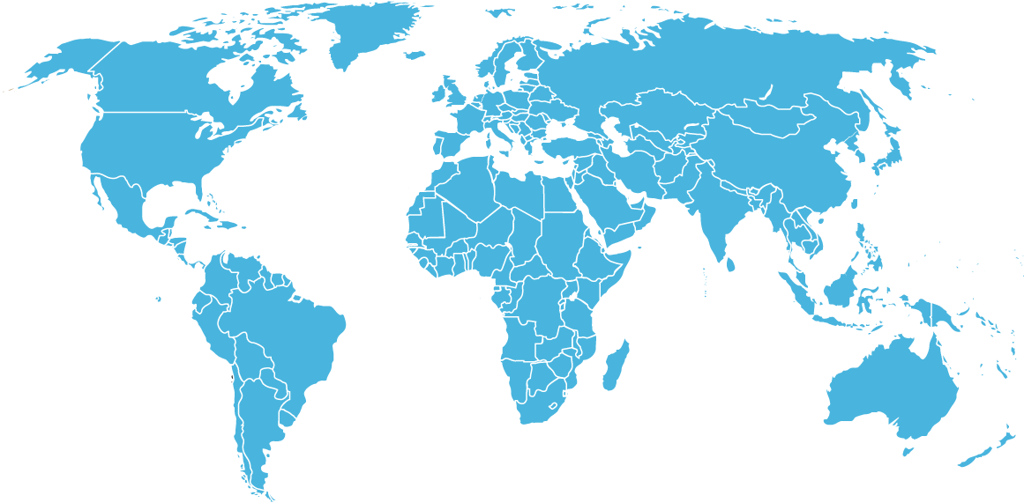





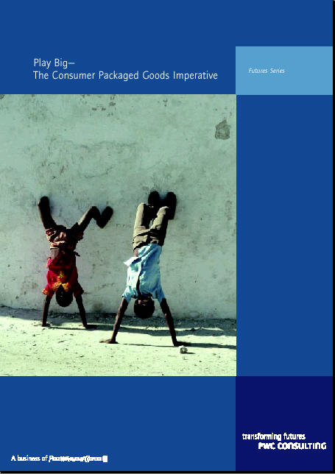
The IBM BCS Consumer Goods Practice is . . .
Global in reach
Based in industry expertise
700 in North America
& Canada
725 in Europe,
Middle East & Asia
600 in Asia Pacific
50 in The
Americas
Supported by research
Driven by client needs
Recent Research Papers:
Consumer Interface, Vols I and II
Data Mining: The Customer Relationship Management Connection
New Retail Economy
The Challenge of the Consumer Millennium
Customer Value Management
Grocery Supply Chains in Asia
Efficient Consumer Response: Responding profitably to consumer needs in Asia
High-quality resources and deployment against specific business needs and locales
Responsiveness to unanticipated needs or developments
Regular engagement and client-relationship feedback processes
Multi-disciplinary engagement teams
Notes:
IBM Consulting’s commitment to the Consumer Goods Industry is reflected in our active participation in consumer goods’ associations around the world.
Key industry groups globally
Americas
GMA
CIES
FCPMC
EMEA
Logicon
ECR Europe
CIES
Asia Pac
ECR Asia
AFGC

Slide 60
With the acquisition of PwC Consulting, IBM Business Consulting Services is a business-services partner of unmatched breadth and depth
IBM Business Consulting Services
World’s largest business consulting practice with 60,000 professionals
World’s second largest strategy consulting organization with over 3,600 strategy professionals globally
Deep expertise in more than 18 industries
Access to the global capabilities of IBM, including integrated technology services, application management services, strategic outsourcing, and global financing
$5 billion annual corporate investment in technology and business research with over $25 million for strategic change intellectual capital alone

Slide 61
In particular, the strategy practice delivers through five capability groups…..
Corporate & Business Strategy
Change Strategy
Building the change architecture and organising the people enablers
Determining where and how the corporation will compete
Technology Strategy & Management
Portfolio & business strategies
Market & customer strategies
Product, pricing & brand strategies
Channel strategies
Value generation strategies
Partnership, alliance & community strategies
Leadership development & culture change
Change & programme management
Technology assimilation
Knowledge management & learning
Defining the role of (Information) Technology in setting and enabling business goals
Technology strategy, design & business alignment
Technology business cases and systems management strategies
Enterprise IT architecture & infrastructure strategies
Technology migration strategies
Application portfolio rationalisation
IT governance
Operations Strategy
Organization Strategy
Developing the business model
Structuring the organization
Operations design & effectiveness
Cross functional operational strategy
Profit improvement strategies
Asset restructuring strategies
Process redesign
Organization design
Organization restructuring
Organization governance

Slide 62

….. That provide a wide range of solutions
Knowledge management & learning
Market & customer strategies
Value generation strategies
- Partnership, alliance & community strategies
Measure and Refine
Anticipate Industry Value
Process redesign
- Leadership development & culture change
- Change & programme management
- Technology assimilation
- Organization Restructuring
Portfolio & business strategies
Product, pricing & brand strategies
Channel strategies
- Technology strategy, design & business alignment
- Technology business cases and systems management strategies
Manage Execution
Value Realization
Develop
Fused
Strategy
Design Execution
Profit improvement strategies
Asset restructuring strategies
Operations design & effectiveness
Cross functional operational strategy
- Enterprise IT architecture & infrastructure strategies
- Technology migration strategies
- Application portfolio rationalisation
- IT governance
- organization design
- Organization governance

Slide 63
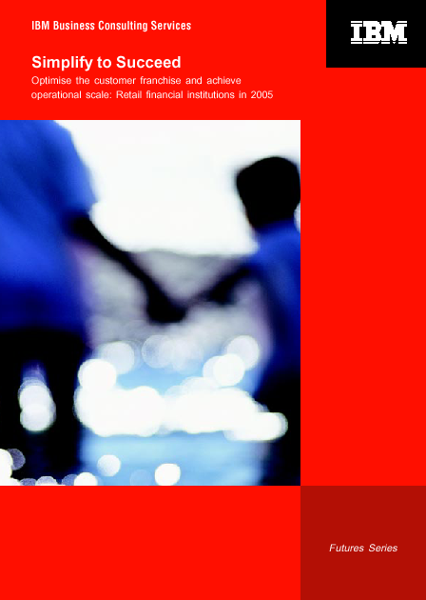
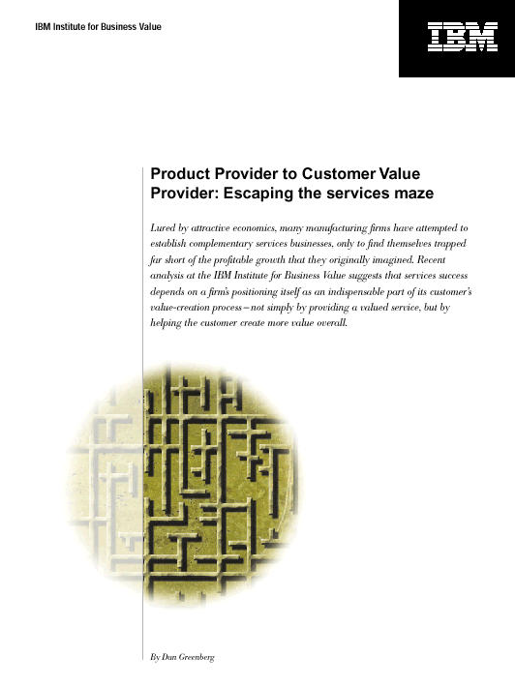
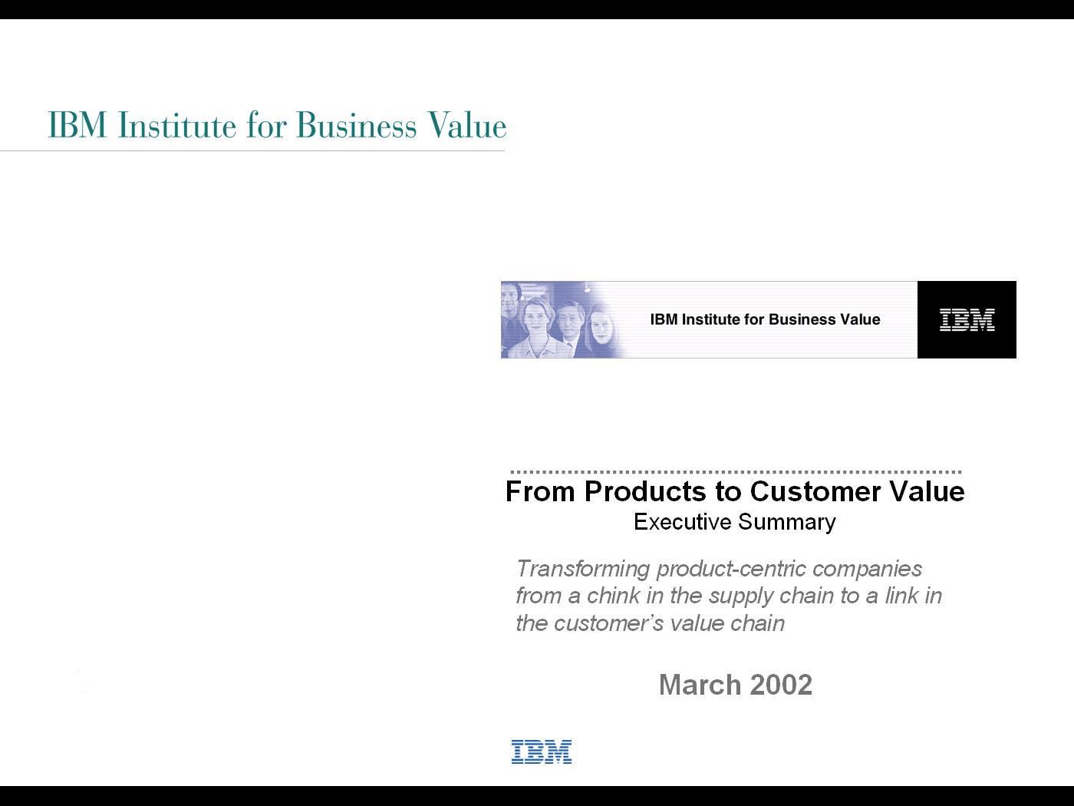
We make significant investments to bring you new and innovative business thinking
Strategic Insights
The world’s second-largest strategic change practice, with over 3,600 professionals globally
Institute for Business Value, staffed by 50 full-time professionals in North America, Europe, and Asia
Over 100 in-depth strategy studies and related publications annually
Focused client membership programs, including up to 20 client events per year
Technology Innovation
World’s largest industrial research group
Eight labs and 3,000+ employees worldwide
$5 billion annual budget and five Nobel prizes
More than 3,400 patents in 2001 (over 75% more than next closest company)
Academic Partnerships
Collaborative research with leading institutions, around the world
Professional staff with teaching positions at key institutions
Joint publications and industry forums
Industry Points-of-View
Comprehensive future-oriented point-of-views
Recommendations for client-specific actions to generate success

Slide 64
Representative experience
Brand Management, sales, and merchandising process alignment for a leading apparel company – This leading marketer of apparel believed its market share was constrained by the effectiveness of its brand management model and go to market processes. We worked with the CEO, Brand Presidents, and the VPs of merchandising and sales to identify pain points and opportunities. We redesigned the model and key processes. We also facilitated the agreement to necessary but contentious changes to the organizations and processes, and developed an implementation plan
Strategy deployment process for a $6.7 billion US food manufacturer - The client faced perennial difficulties in operationalizing its strategic plans, agreeing budgets, and meeting operating targets. Our diagnostic identified the weak link as the translation of market based strategic goals into the necessary set of capability building and innovation initiatives. We worked with the CFO to develop the process and disciplines to identify and manage the initiatives necessary to execute the strategies
Global pricing strategy and process for a leading marketer of premium fragrances and toiletries - Following a period of aggressive international growth, the client was suffering increasing ‘diversion’ of its products across countries and channels. Consequently, the product was available in low image ‘doors’, and the client found it difficult to read ‘real’ volumes by channel and country to manage brand investments. We worked with the CFO and country managers to develop a root cause analysis and identify threshold price differences that encouraged diversion. We then factored in country volumes and pricing to model the diversion and profit impact of various pricing strategies. Recommended changes in pricing strategy, and developed an ongoing process to maintain pricing integrity

Slide 65
Representative experience
Operational model for a European hair-care client – Identified operational and process capability gaps against aggressive growth plans. Developed alternate supply chain strategies to support wider and deeper distribution, including options like trucking, regional distribution centers, and depot co-location with distributors. Analyzed costs and benefits of alternative network configurations against business scale, developed implementation plans for the recommended option. Redesigned the demand forecast process to standardize inputs. Developed and implemented a Sales and Operations Planning process
For a leading apparel manufacturer, identified idea originators, and explored processes for recognizing and rewarding innovators, encouraging and managing dissent, and surfacing and resolving disagreement. Also explored changes needed to achieve competencies, steps needed to encourage entrepreneurship at all levels, and created a sharper understanding of what is the most appropriate management and leadership style
For a large European-based brewer, identified conditions for developing climate of innovation. Defined climate creators, existing climate in key workgroups, and explored changes needed to improve climate. Developed approach to address strategic issues such as relation between corporate culture and local climate, and explored how recruitment and promotion criteria need to change

Slide 66
Representative experience
Identified and implemented enhanced Efficient Consumer Response (ECR) initiatives to improve competitiveness and productivity for a major international consumer products manufacturer. This effort covered the full spectrum of ECR and required the integration of cross-function effort throughout the enterprise. Focusing on the merchandising process, assessed the customer's capabilities relative to the best practices in the industry, and identified areas in which shortfalls existed. The team calculated the value of eliminating these shortfalls, and recommended the steps needed to elevate the business practices to meet the standards of best practices
Conducted a review of the strategy and operational model of a national leader in snacks and bakery. Reviewed this successful business that had strong consumer opportunities but was experiencing an increasing inability to realize them. Identified volume shifts to mass and hyper as the key forces challenging the traditional Direct Store Delivery approach the firm believed essential to its success. Modeled the valuation consequences of staying with the current model to generate the momentum for change. Developed alternative channel and service models to maintain core DSD functionality but respond to hyper channel needs. Evaluated these on strategic, economic, and competency criteria. Identified operational requirements and modifications to key supply chain and channel management processes.

